Slide 1

Data Cleaning and Wrangling
Kavana Ravishankar

Slide 2
Introduction
This project aims to clean and structure MLS viewership (AMA) data from Apple TV+ to align with Trajektory’s required format.
Objective: The primary goal is to prepare the MLS data for accurate reporting, with a focus on documenting each step in the data-cleaning and structuring process.
For this project, I utilized Python as my primary tool for data cleaning and wrangling.

Slide 3
Objectives
The main tasks include:
Transform the raw MLS data into a standardized format suitable for Trajektory’s reporting needs specified in “streaming landing” format.
Identify and document any games present in the MLS data that are missing from the Trajektory events tab, and vice versa.
Provide a clear, documented process for each step taken, preparing the data efficiently for analysis and reporting.

Slide 4
Data Overview
MLS Data: Contains raw AMA data from Apple TV+.
Trajektory Events: List of games Trajektory is contracted to value.
Trajektory_mls_team_dim: Contains team names and corresponding keys.
Streaming Landing: Desired format for the cleaned data.
Missing games: Games in the MLS data that are missing from the Trajektory events tab and vise versa

Slide 5

Split 'event_name' into 'away_team_name' and 'home_team_name' and mapping
14
1
Loading and Inspecting Data
Perform inner join to get common games
13
2
Dropping duplicates(check)
Perform an outer join to find missing games
12
3
Dropping columns
Data Cleaning & Wrangling Process
Create the event_name column in the format Away Team @ Home Team
11
4
Fixing data/Data Standardization
Standardize team names in mls_data by mapping
10
5
Handling missing/Nan values
Split the EVENT_TITLE column at
"vs" into home_team and away_team
9
6
Dropping rows where AMA is empty
Group by event_date, event_title & sum AMA
8
7
Standardize data - DATE to event_date

Slide 6
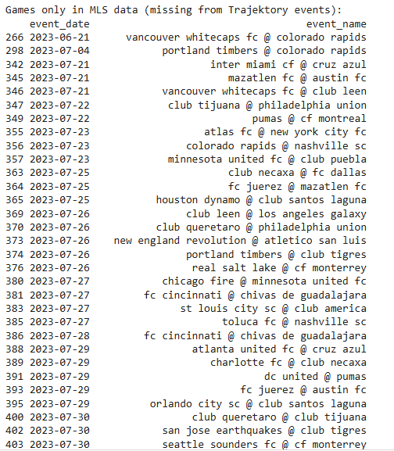
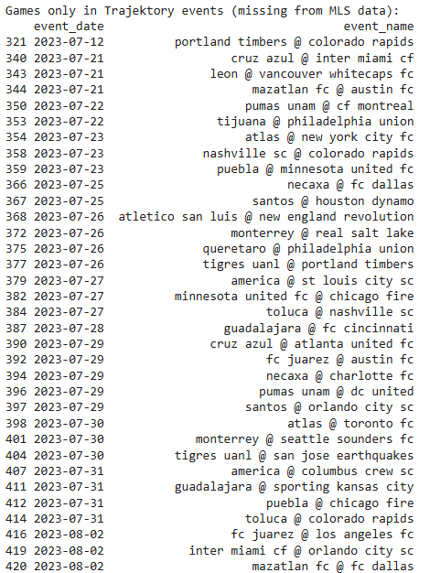
Missing games
Games only in MLS data (missing from Trajektory events):
Games only in Trajektory events (missing from MLS data):

Slide 7
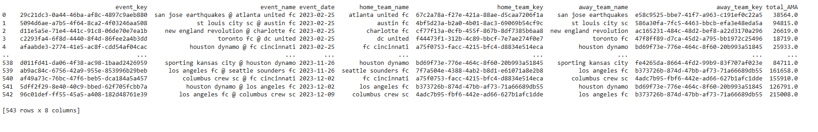
Streaming_landing page

Slide 8
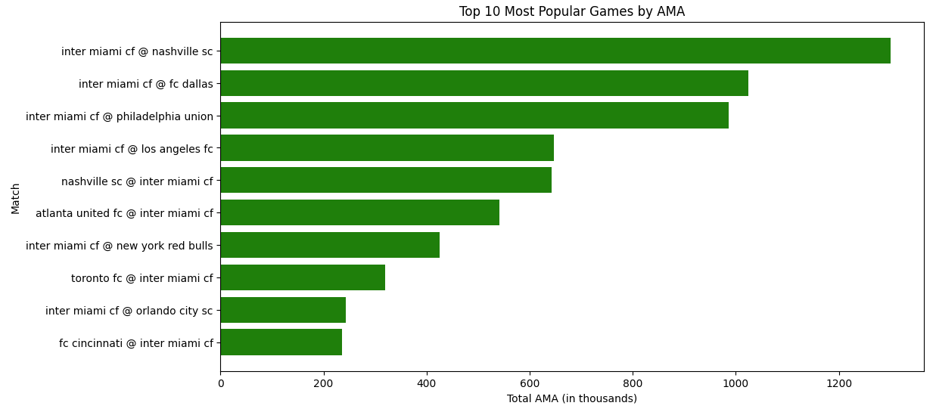
Insights from visuals
Insights from the Data:
The most popular game achieved a significantly higher AMA compared to others.
Provides valuable insights into viewer preferences and high-engagement events.

Slide 9
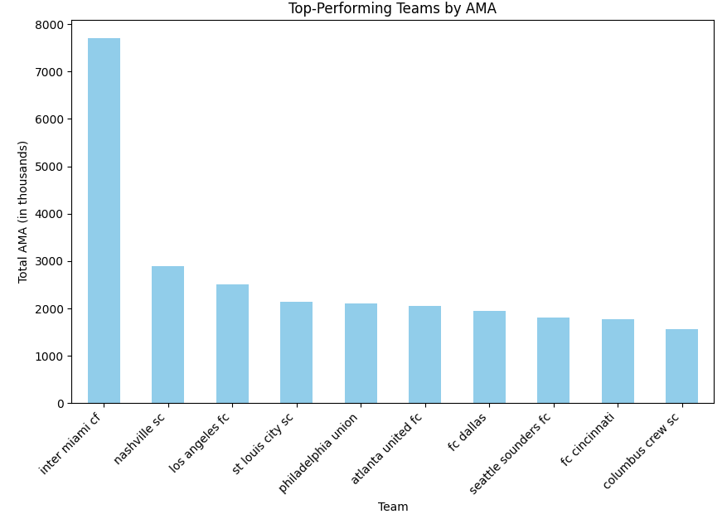
Insights from visuals
Insights from the Data:
Combines AMA contributions from both home and away matches for each team.
Teams are ranked by their total AMA, scaled to thousands for easier interpretation.
The top-performing team significantly surpasses others in total audience engagement.

Slide 10
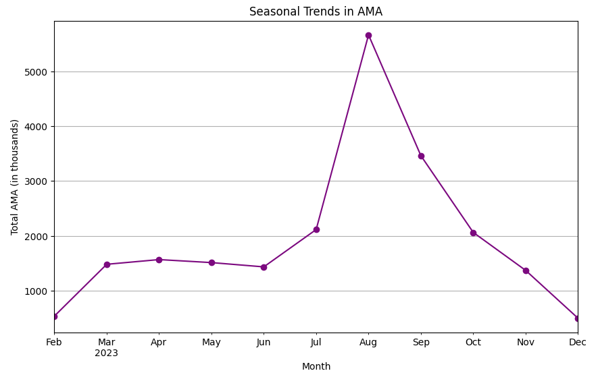
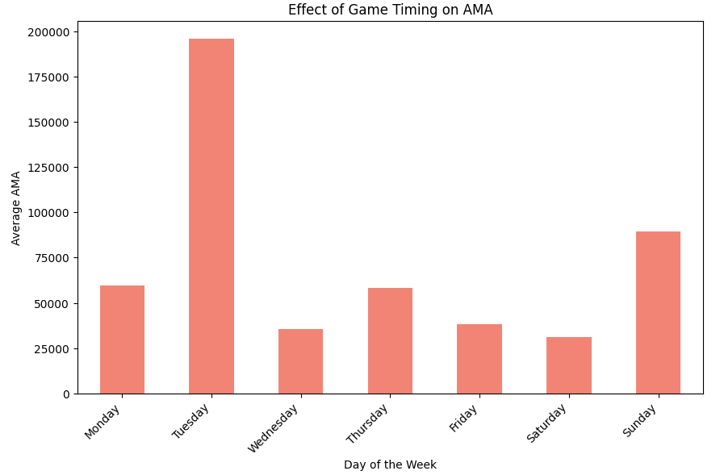
AMA peaks in August, indicating higher viewership during this month, followed by a sharp decline in the later months
Tuesday games attract the highest average AMA, with Sunday also showing strong viewership compared to other days

Slide 11
This data cleaning process transformed raw MLS viewership data into a structured format aligned with Trajektory's reporting needs.
By removing duplicates, handling missing values, standardizing team names, and merging datasets, tried to ensure consistency and accuracy in the final data.
This prepared dataset is now ready for effective analysis and reporting, laying a foundation for insightful evaluation of MLS game viewership.
Conclusion

Slide 12

“Data is like a puzzle – when you clean, organize, and fit the pieces together, you get a clear picture of the story it wants to tell.”

